Slide 1
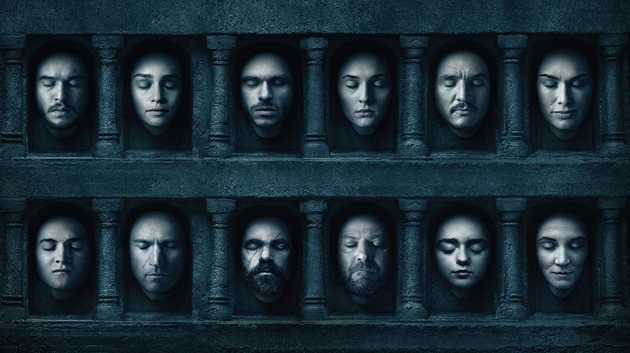
A SONG OF GRAPH AND ANALYTICS

Slide 2
Agenda..
1
STORY – CONTEXT
INDIVIDUAL SEASON –
OVERVIEW OF NETWORK METRICS
OVERALL STORY ANALYSIS –
OVERVIEW OF NETWORK METRICS
FUTURE SCOPE AND DEMO
2
3
Team Dosa
4
Arun Kumar Balasubramanian (A0163264H)
Abhilasha Kumari ( A0163276B)
Devi Vijayakumar (A0163403R)
Prashant Jain (A0163380J)
Praveen Tiwari (A0163322R)
Data Source

Slide 3
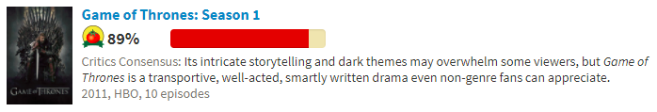
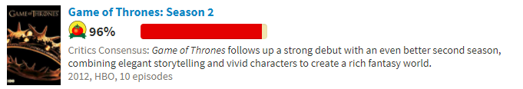
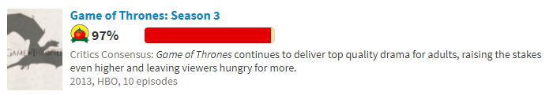
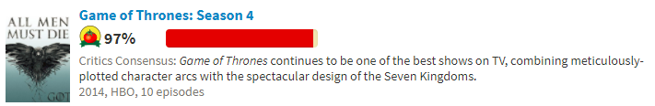
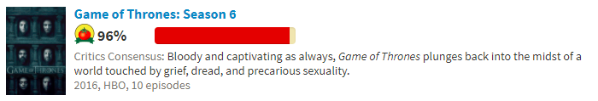
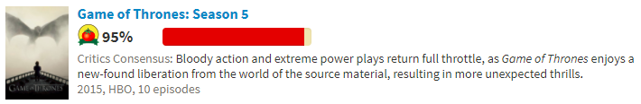
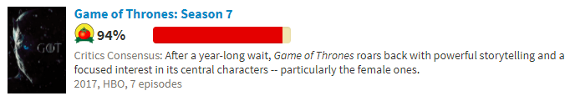
Story….
https://prezi.com/ky1i0bartnbx/game-of-thrones/
Graph mining tool: Gephi

Slide 4
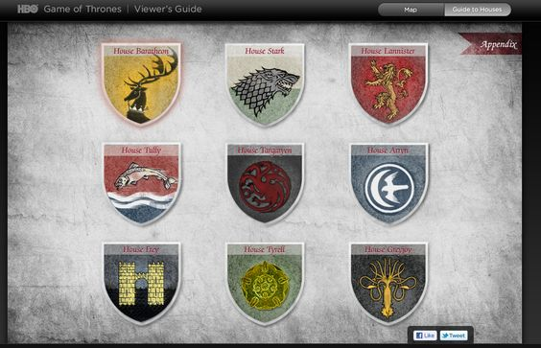
Season 0…
Average Degree: 1.364
Density: 0.010
Diameter: 6
Average Path length: 2.1796875
Average Clustering Coefficient: 0.177
11 major coherent communities have been identified.
Topmost: Lannisters, Starks, Targaryens, Tyrells, Direwolfs & etc.
The clustering coefficient is a measure of an "all-my-friends-know-each-other" property. This is sometimes described as the friends of my friends are my friends
Initially, there was peace and no chaos or separation .All houses lived in harmony. The clustering coefficient was higher compared to the overall scenario and the other seasons.
Houses

Slide 5
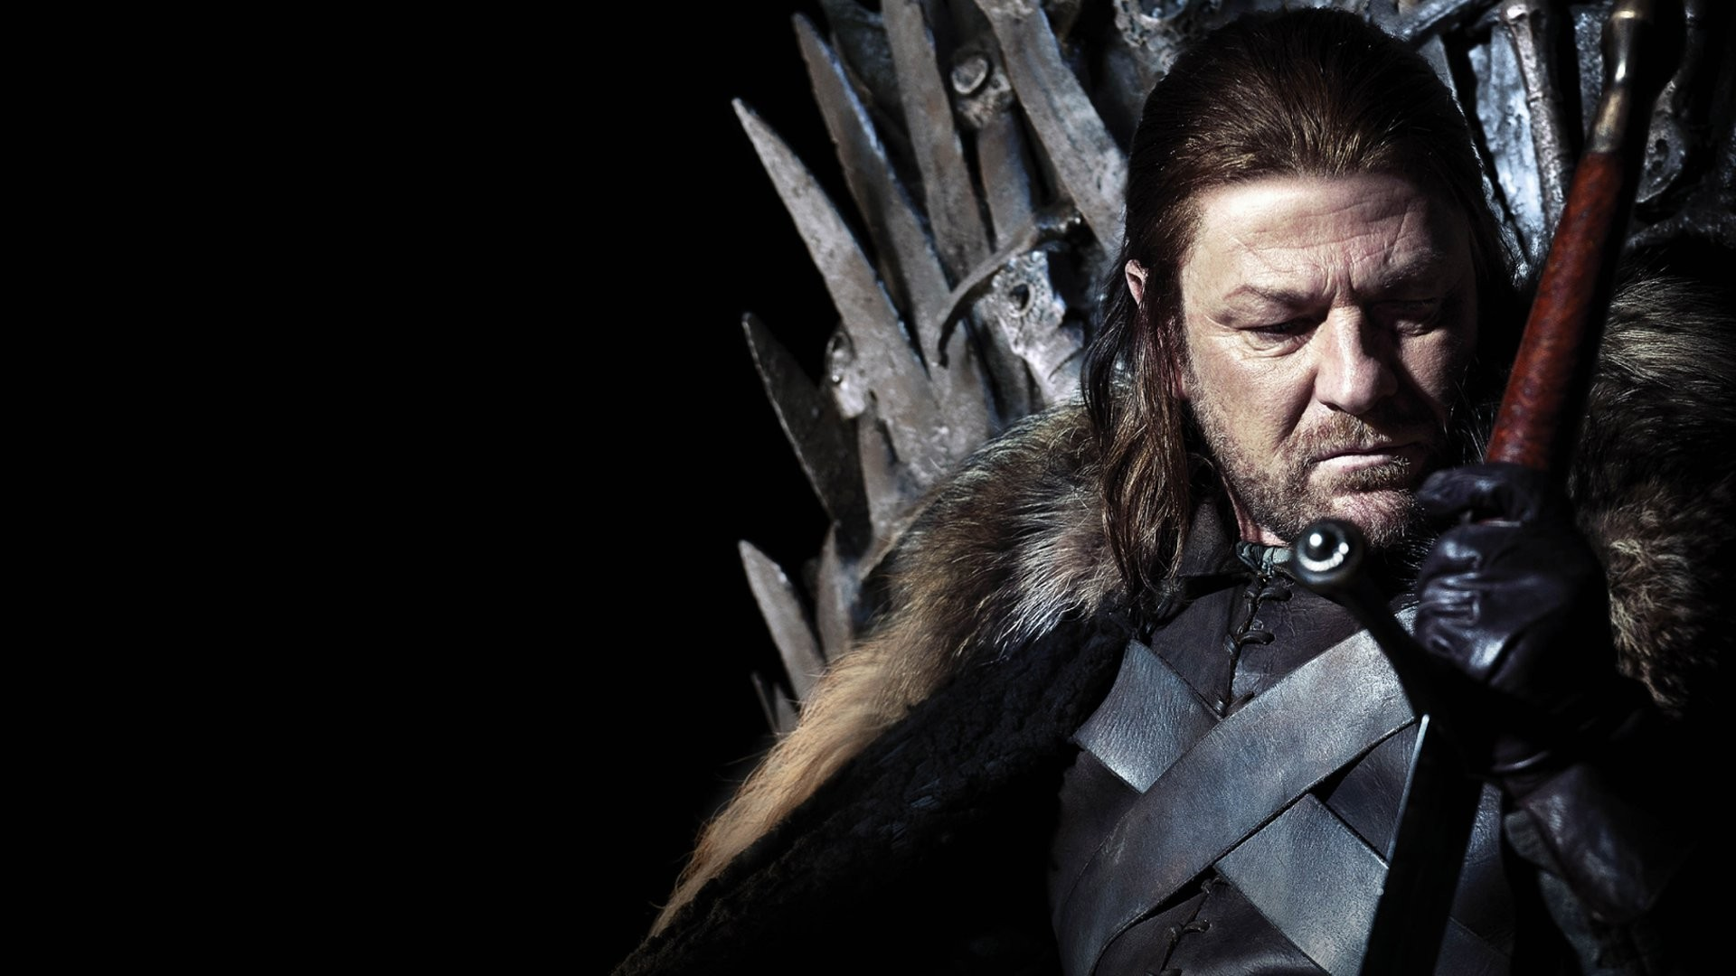
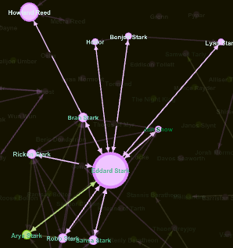
Insight - Season 0 shows the relationship and the closeness of stark community which was lead by Ned Stark who was supported by family members and friends.
Key player in the community.
Eddard Stark

Slide 6
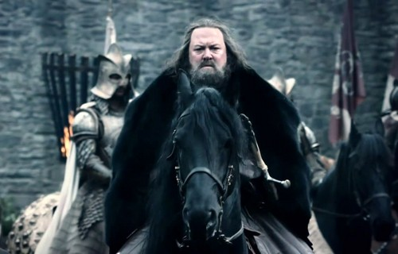
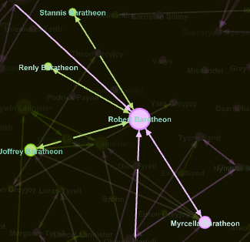
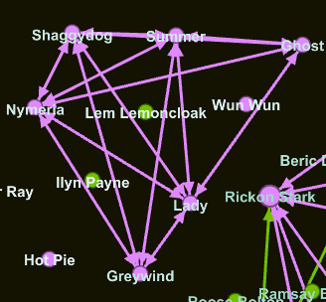
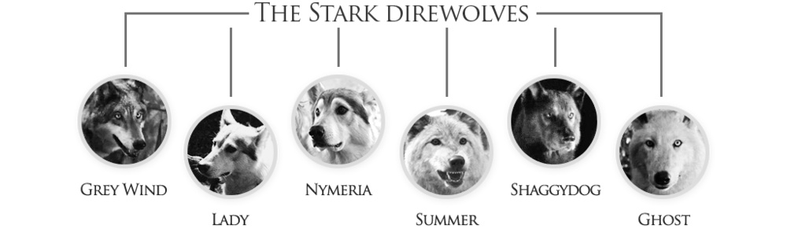
Insight - The king of the Westeros and his family. The betweenness is high as he is the king of the all the lands.
Insight - Clique can be found between the orphan dire wolves who gets later adopted. As they belong to a Stark family a maximal clique had been formed.
Robert Baratheon

Slide 7
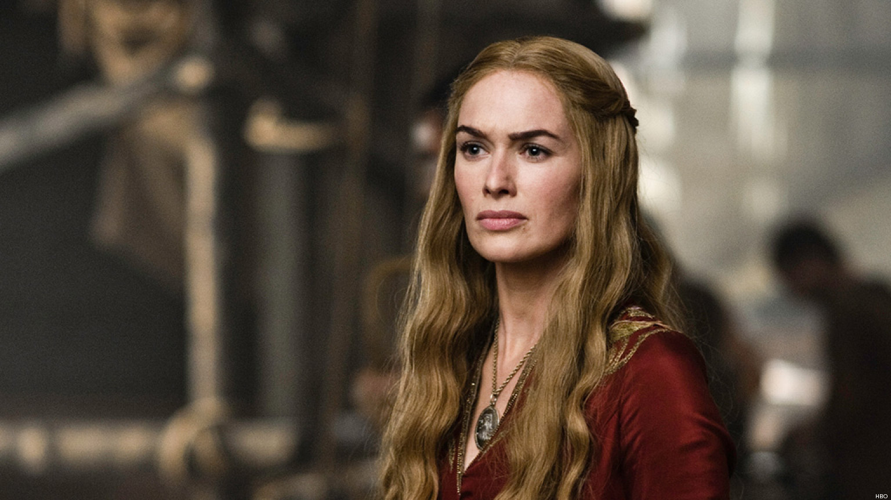
Season 1…
Average Degree: 1.464
Density: 0.011
Diameter: 8
Average Path length: 3.0159680638722555
Average Clustering Coefficient: 0.136
7 major coherent communities have been identified.
Topmost: Starks, Lannisters, Targaryens, Night Watch, Baratheon etc.
Insight - A small community of Daenerys which is getting created and is a competition for the throne and the king gets to know about it.
Key player in the community is identified to be Cersei Lannister.
Cersei Lannister

Slide 8
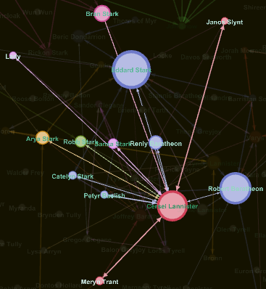
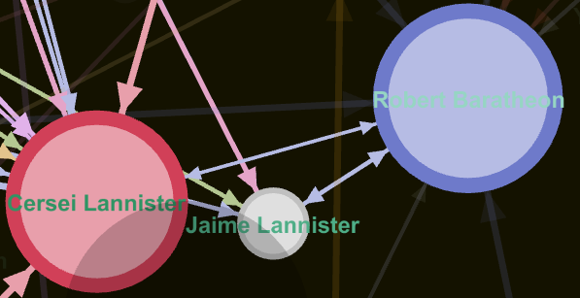
Key player due to betweenness in season which can be attributed to Cersei Lannister who is the wife of the King and wants her husband to be dead and her own son to take over the throne. As we can see she had been key attribute in communicating with her husband and the possible king after her husband.
Insight - She shares a relationship between the key members of many other communities indicating her importance.
Insight - Hidden and secret relationship can also be found out between the queen and her brother Jaime. This can be considered as a Small Tripartite network were all are mutually related to each other.

Slide 9
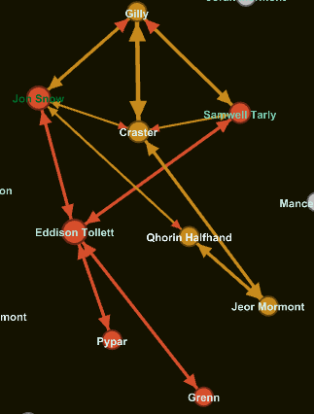
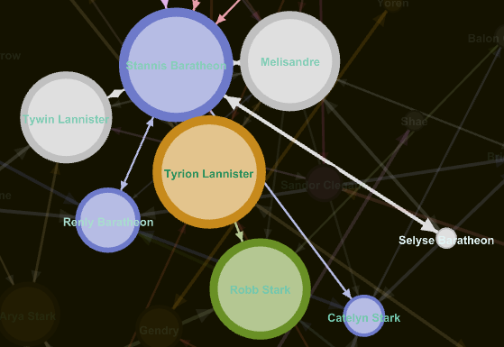
Season 2…
Average Degree: 1.071
Diameter: 8
Average Path length: 3.2725306416726747
Density: 0.008
Average Clustering Coefficient: 0.096
8 major coherent communities have been identified.
Topmost: Stannis’s Army, Arya & friends, Robb Stark, Tyrion & etc.
Insight - People hopping into different communities and forming a new community by creating a Clique.
.

Slide 10
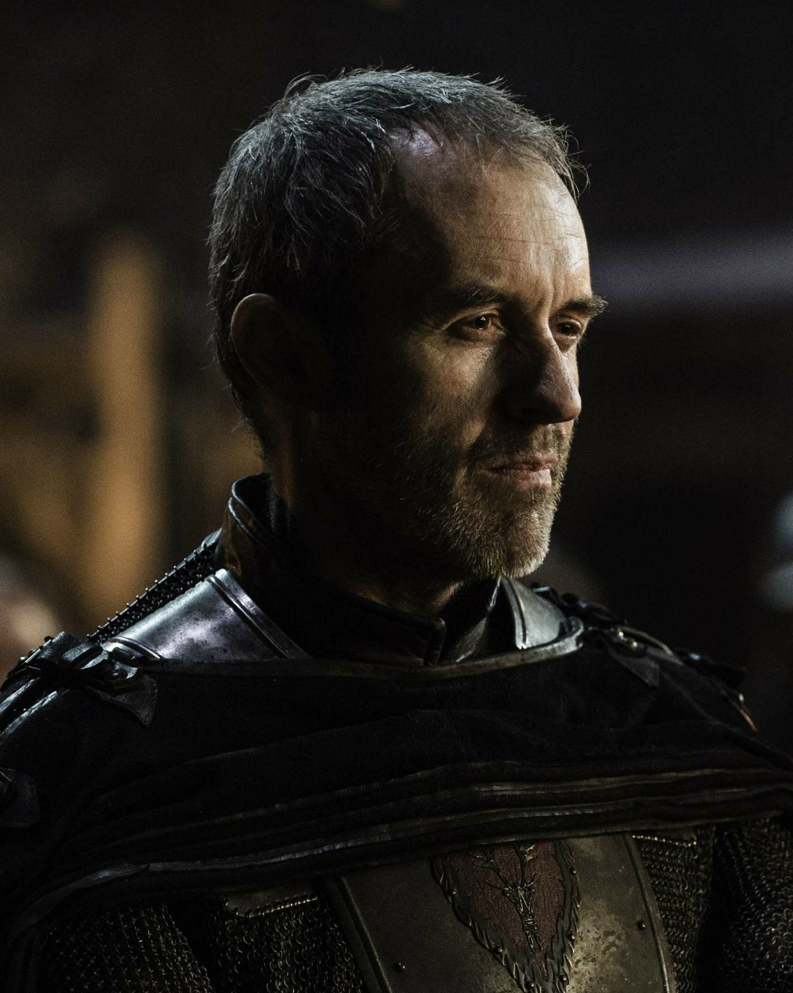
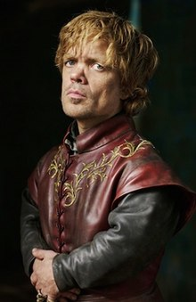
Insight - It portrays the importance of the two characters dominating in this season as it can be related to the war that happened between them.
Key players are Tyrion & Stannis in their respective community.

Slide 11
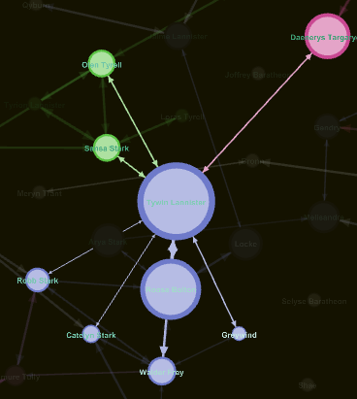
Season 3…
Average Degree: 0.929
Density: 0.007
Diameter: 9
Average Path length: 3.5448851774530272
Average Clustering Coefficient: 0.101
5 major coherent communities have been identified.
Topmost: Targaryen army, Boltons, Tywin Lannister, Wildlings & etc.
.

Slide 12
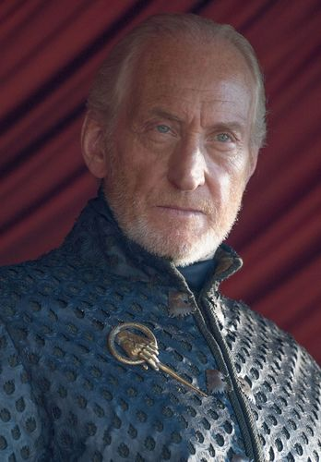
Insight - It shows how important this character in making a series of events. The character leads to series of big events by chained connection.
Insight - This season portrays the importance of this character across the entire communities and how his decision can affect the relationship and links between and within the communities.
Key player in the community is identified to be Tywin.
Tywin Lannister

Slide 13
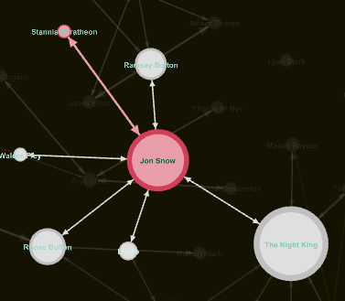
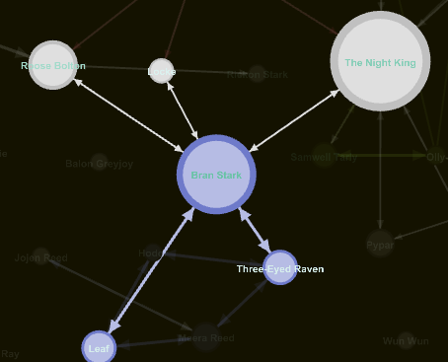
Season 4…
Average Degree: 0.950
Density: 0.007
Average Clustering Coefficient: 0.068
Diameter: 9
Average Path length: 3.18172268907563
5 major coherent communities have been identified.
Topmost: Bran stark, Jon Snow, Cersei & etc.
.

Slide 14
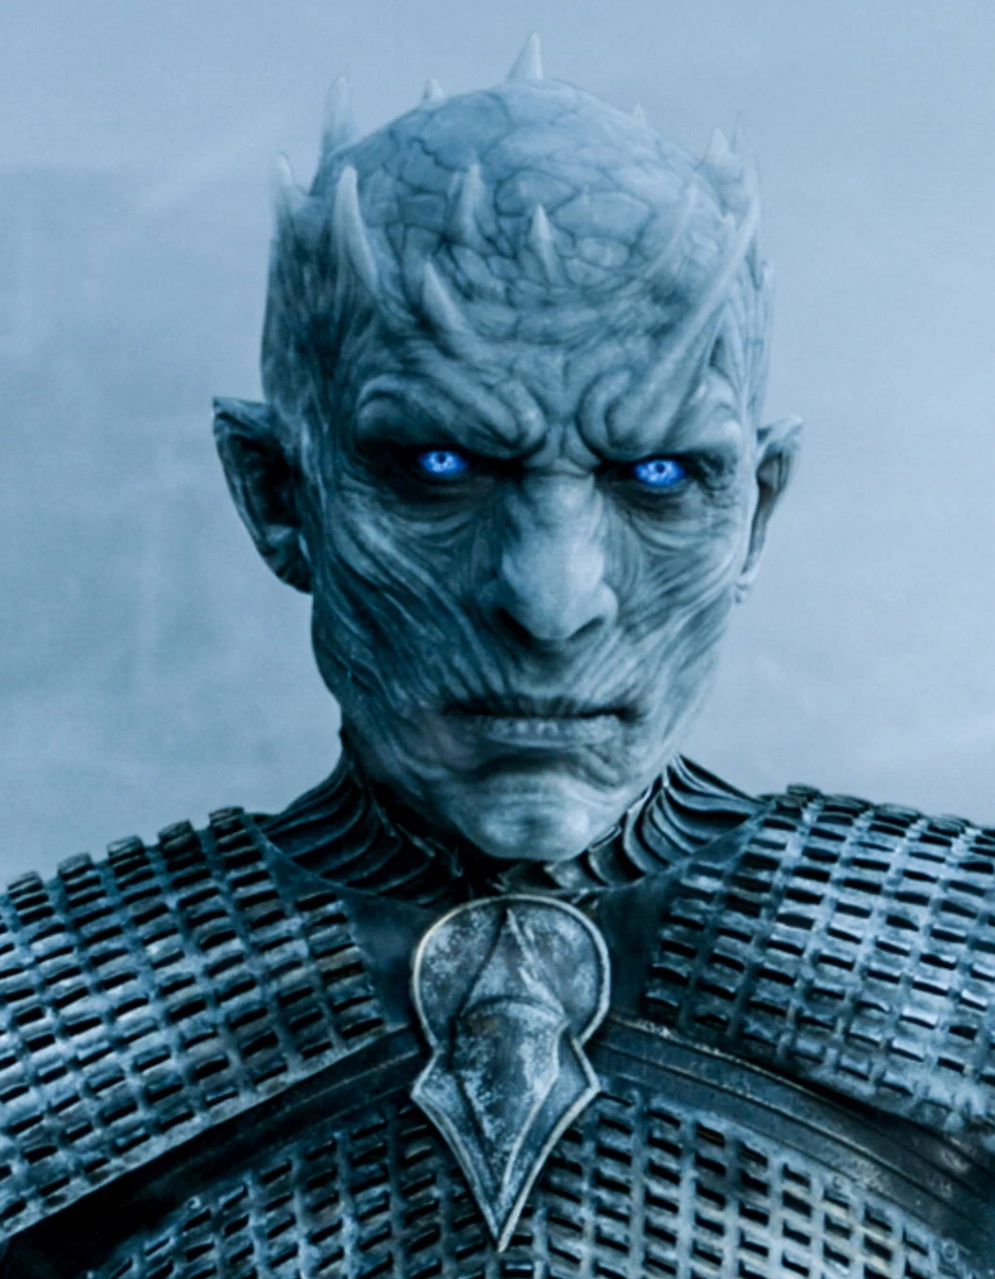
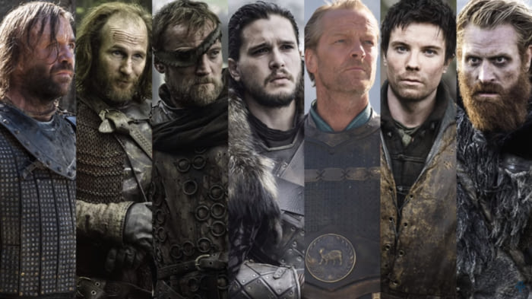
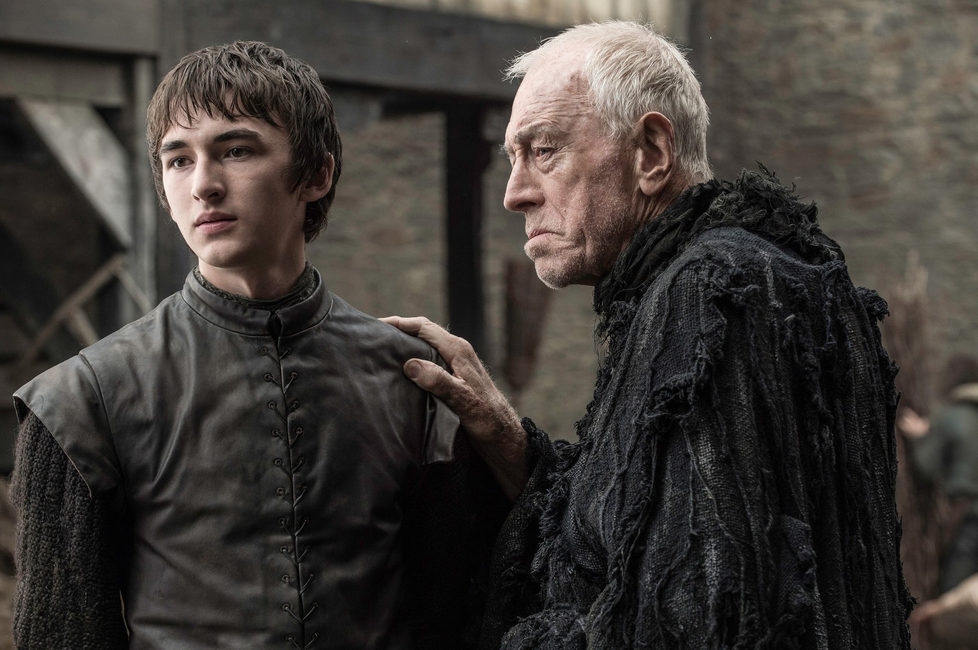
Color
Palette
Season 4 Insights…
Insight - Jon Snow raises army against the Night King. The network portrays this new community and how they co-ordinate against the enemy.
Insight - Hidden community too has been detected who is against the common enemy.
.
HEX
#981300
HEX
#E39920
HEX
#E9D8BF
HEX
#5BB0B2

Slide 15
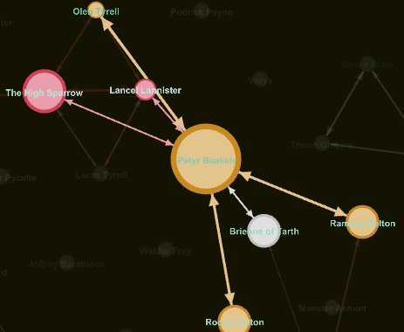
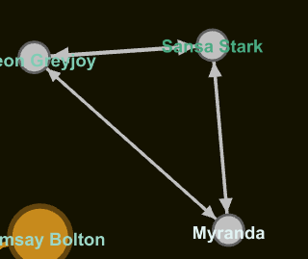
Season 5…
Average Degree: 0.950
Diameter: 9
Average Path length: 3.3313069908814588
Density: 0.007
6 major coherent communities have been identified.
Topmost: High Sparrow, Stannis, Petyr Baelish & etc.
.

Slide 16
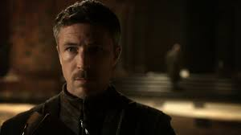

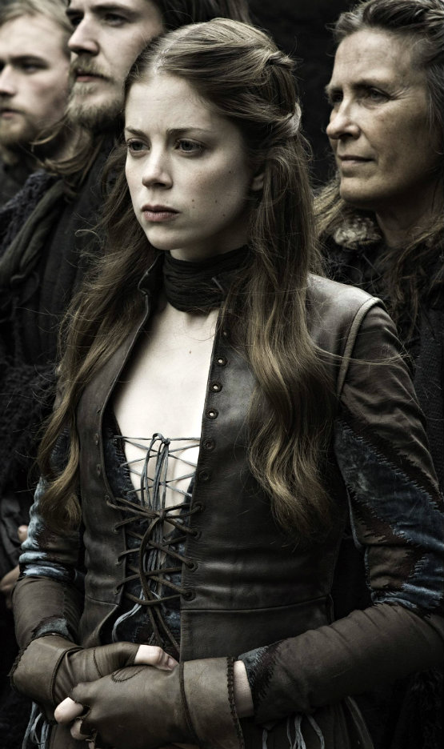
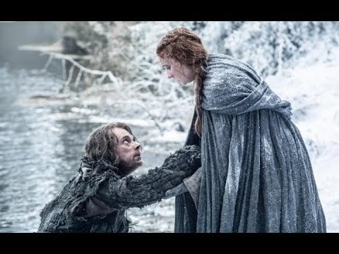
Color
Palette
Season 5 Insights…
Insight - Petyr Baelish(Little finger)-This season portrays how a character who seemed to be not a key player has evolved across time and is a key decision maker in the movement of story. Key player in the community.
Insight - A tri-partite smaller community Clique detected which gets separated and in turn leads to formation of a new community in the upcoming seasons.
.
.
HEX
#981300
HEX
#E39920
HEX
#E9D8BF
HEX
#5BB0B2

Slide 17
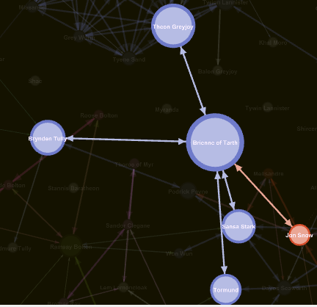
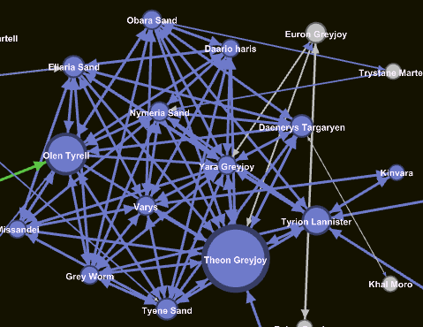
Season 6…
Average Degree: 2.186
Diameter: 11
Average Path length: 4.283783783783784
Density: 0.016
Average Clustering Coefficient: 0.167
5 major coherent communities have been identified.
Topmost: Cersei, Danerys, Jon Snow & Bran Stark
.

Slide 18
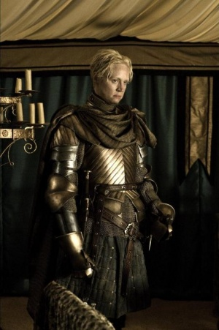
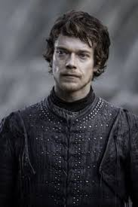
Season 6 Insights
.
Insight - As we can see there has been multiple communities which has been formed without coordination and the network diameter has grown in this season which can also be associated with the Average Path length increase.
A key player who plays the role of binding with every community and carries mutual information across the communities.
Insight - A maximum Clique which was formed to destroy the common enemy and attain the throne against their brutal queen.
Key players in their community are Theon & Brienne.
Theon Greyjoy
HEX
#4E0E05
.
HEX
#981300
HEX
#E39920
HEX
#E9D8BF
HEX
#5BB0B2

Slide 19
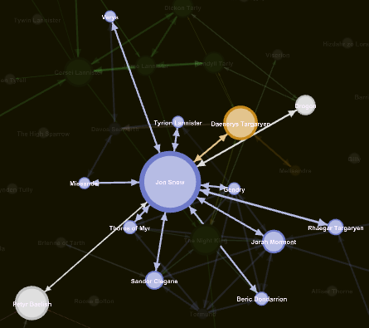
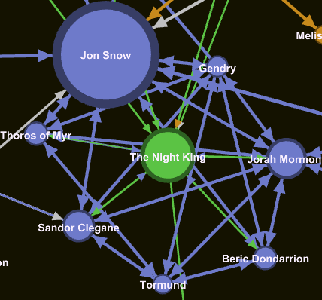
Season 7…
Average Degree: 0.929
Density: 0.007
Diameter: 8
Average Clustering Coefficient: 0.070
Average Path length: 3.453769559032717
3 major coherent communities have been identified.
Topmost: Jon Snow, Danerys and Cersei

Slide 20

Color
Palette
Season 7 Insights…
The number of unique clusters are reduced to a large extent as all the communities understood they fight against a single common enemy i.e. Night King. Thereby many communities formed into allies to fight against a common enemy.
Moreover, a key player who knows about the common enemy has been enhanced.
Insight - A maximal Clique getting formed surrounding the common enemy with the king
Jon Snow is the key player in the community as the latest season is completed.
HEX
#E39920
HEX
#5BB0B2

Slide 21

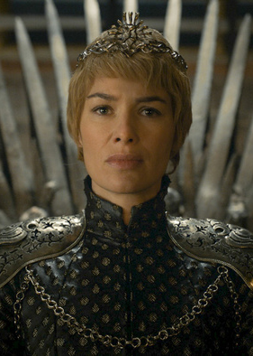
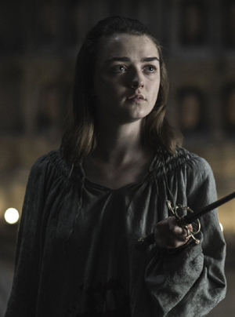
Overall (Season 1-7)…
Average Degree: 8.479
Diameter: 6
Density: 0.061
Average Path length: 2.687410071942446
Average Clustering Coefficient: 0.538
Nodes: 140
Edges: 1378
4 major coherent communities have been identified.
Topmost: Cersei, Tyrion, Danerys & Jon Snow
Insight - In the overall network, there are few notable key players who initially started low profile and have led to the formation of huge communities due to their season wise impact.
Insight - John Snow a key player who gathers armies and allies to fight against the Night King and it can also be noticed that the key player also has information from other key players

Slide 22
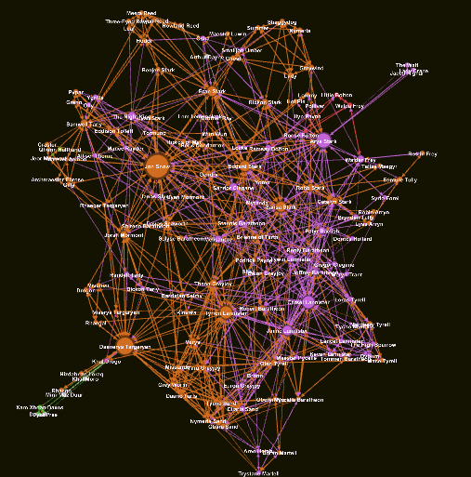
Overall (Season 1-7)…
DEGREE DISTRIBUTION
CLUSTERING COEFFICIENT DISTRIBUTION
For the Overall season, the network is a scale free network.
The distribution follows Power law distribution indicating it is a scale free network.
Clustering coefficient distribution also indicates that it is a Scale-free networks with modularity structure also known as hierarchical network.

Slide 23
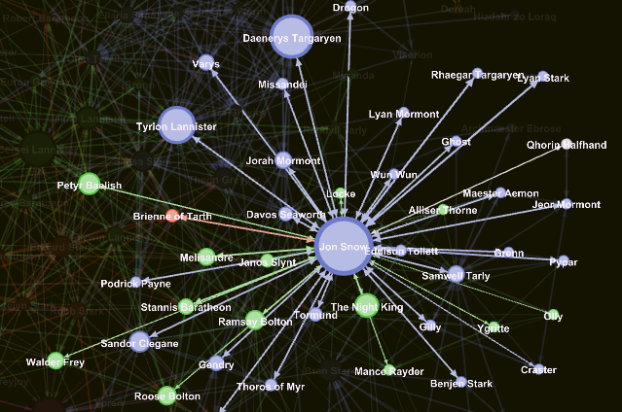
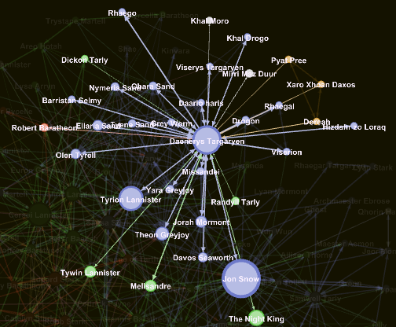
Jon Snow’s Community Dany’s Community merging with Jon Snow

Slide 24
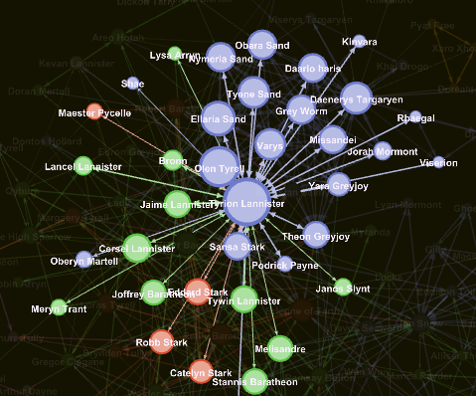
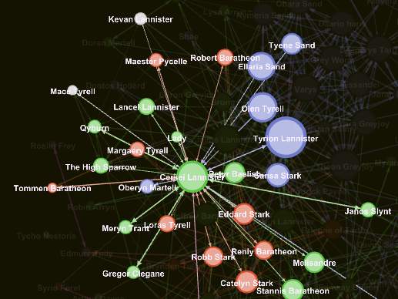
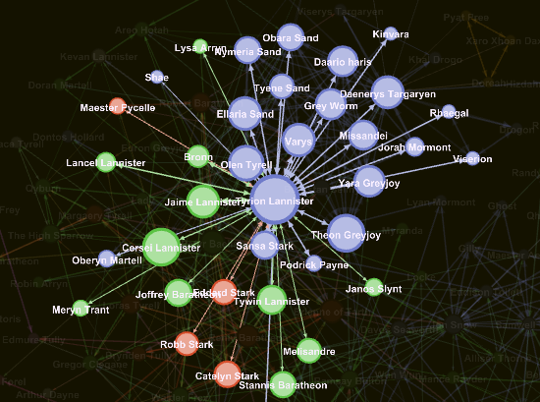
Authority of Tyrion Authority of Cersei Hub of Tyrion

Slide 25
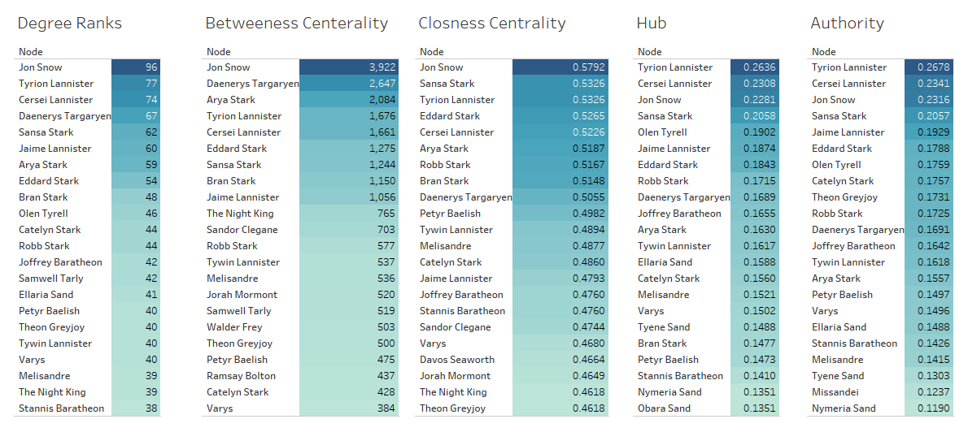

Slide 26
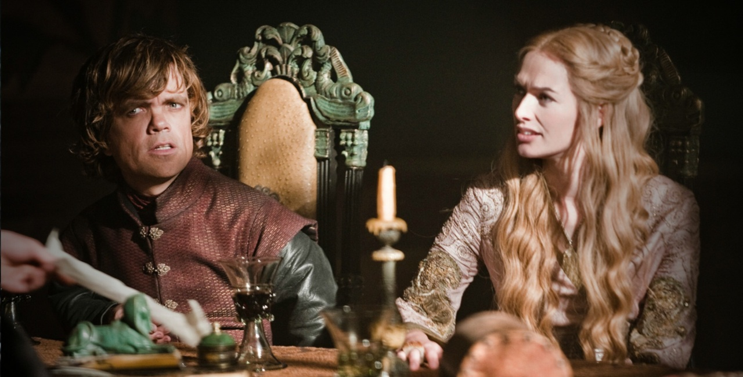
Overall (Season 1-7)…
A community which was started from the scratch by the key player Danerys and now merging with another community to fight against a common enemy.
Hub:
Very evident as Tyrion is the Major Hub as he knows most of the information and is responsible for inter community contacts.
Authority:
Being the queen, Cersei, can be associated as having the highest authority.
Insight - Being one of the key decision maker due to the gathering of data and being a hub Tyrion is the most important character of the entire story as he has the authority and hub. Besides Tyrion, Jon Snow and Daenerys are the powerful characters in the network to create strong relationship or hatred among houses.

Slide 27


Future Scope and Improvements…
Game of thrones is a mysterious story with huge hidden, complex and shocking relationship and network. The relationships can be understood if we collect more data.
The Hub and the authority gives us the overview of where the power and control lies in the story, using that we can leverage on battle prediction in the upcoming story.
Using advance machine learning algorithms like Deep learning we can also predict the death of characters in the story as Game of thrones has lot of unpredictable character deaths.
Game of thrones is a long story and using graph network we can communicate the story effectively and shortly.

Slide 28



BEWARE

Slide 29

THANK YOU

